Slide 1
PREDICTIVE MAINTENANCE MODEL
CAPSTONE PROJECT
Presented By: TEJASVI
College Name: Sanskaram University
Department: Engineering and Technology

Slide 2
OUTLINE
Problem Statement
Proposed System/Solution
System Development Approach
Algorithm & Deployment
Result
Conclusion
Future Scope
References

Slide 3
Problem Statement
Develop a predictive maintenance model for a fleet of industrial machines to anticipate failures before they occur. This project will involve analyzing sensor data from machinery to identify patterns that precede a failure. The goal is to create a classification model that can predict the type of failure (e,g., tool wear, heat dissipation, power failure) based on real-time operational data. This will enable predictive maintenance, reducing downtime and operational costs.

Slide 4
Proposed Solution
The proposed system aims to address the challenge of predicting the required maintenance for machines to ensure reduced downtime and operational costs. This involves leveraging data analytics and machine learning techniques to forecast possible machine failures that needs to be resolved. The solution will consist of the following components:
Data Collection:
Gather data on machines type, including air temperature, speed, torque, and other relevant factors.
Utilize real-time data sources, such as process temperature, tool wear, and failure type to enhance prediction accuracy.
Data Preprocessing:
Clean and preprocess the collected data to handle missing values, outliers, and inconsistencies.
Feature engineering to extract relevant features from the data that might impact machine failures.
Machine Learning Algorithm:
Implement a machine learning algorithm, such as Snap Random Forest Classifier to predict machine failures based on historical patterns.
Consider incorporating other factors like temperature, target, and failure type to improve prediction accuracy.
Deployment:
Develop a user-friendly interface or application that provides real-time predictions for machine’s wear status.
Deploy the solution on a scalable and reliable platform, considering factors like server infrastructure, response time, and user accessibility.
Evaluation:
Assess the model's performance using appropriate metrics such as Mean Absolute Error (MAE), Root Mean Squared Error (RMSE), or other relevant metrics.
Fine-tune the model based on feedback and continuous monitoring of prediction accuracy.
Result:

Slide 5
System Approach
System requirements
Platform: IBM Cloud (Lite Plan)
Service Used: Watsonx.ai Studio
Operating Environment: Cloud-based, no local installation required
Compute Resources: Managed automatically by IBM Cloud
Data Storage: IBM Cloud Object Storage (Lite Tier)
Library required to build the model
Watsonx.ai Studio
AutoAI
Watson Machine Learning (WML)

Slide 6
Algorithm & Deployment
Algorithm Selection:
The SNAP Random Forest Classifier was selected for its robustness and ability to handle imbalanced and high-dimensional data. It delivers accurate predictions by combining multiple decision trees, making it ideal for predictive maintenance where equipment failure patterns can be complex and non-linear.
Data Input:
The model requires Product ID, Machine type, air temperature, process temperature, rotational speed, torque, tool wear, and target from the user to determine the failure type.
Training Process:
The SNAP Random Forest Classifier was trained using historical machine data through automated preprocessing, feature engineering, and model optimization. AutoAI employed cross-validation and hyperparameter tuning across multiple pipelines to select the most accurate model for predicting failure types.
Prediction Process:
The trained SNAP Random Forest Classifier analyzes real-time input data using patterns learned from historical failures. It evaluates multiple decision trees to classify the likelihood of specific failure types, enabling timely and accurate maintenance predictions. Real-time data input such as temperature, rotational speed , tool wear and target are taken in account while prediction.

Slide 7
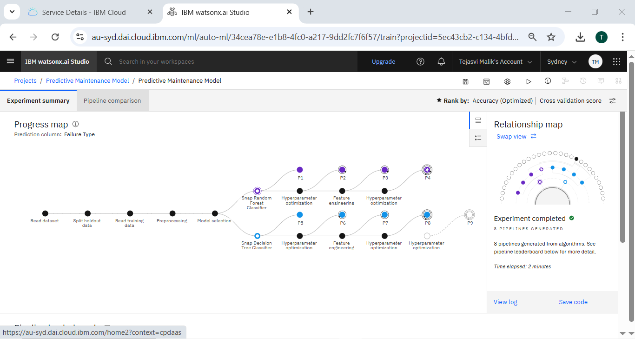
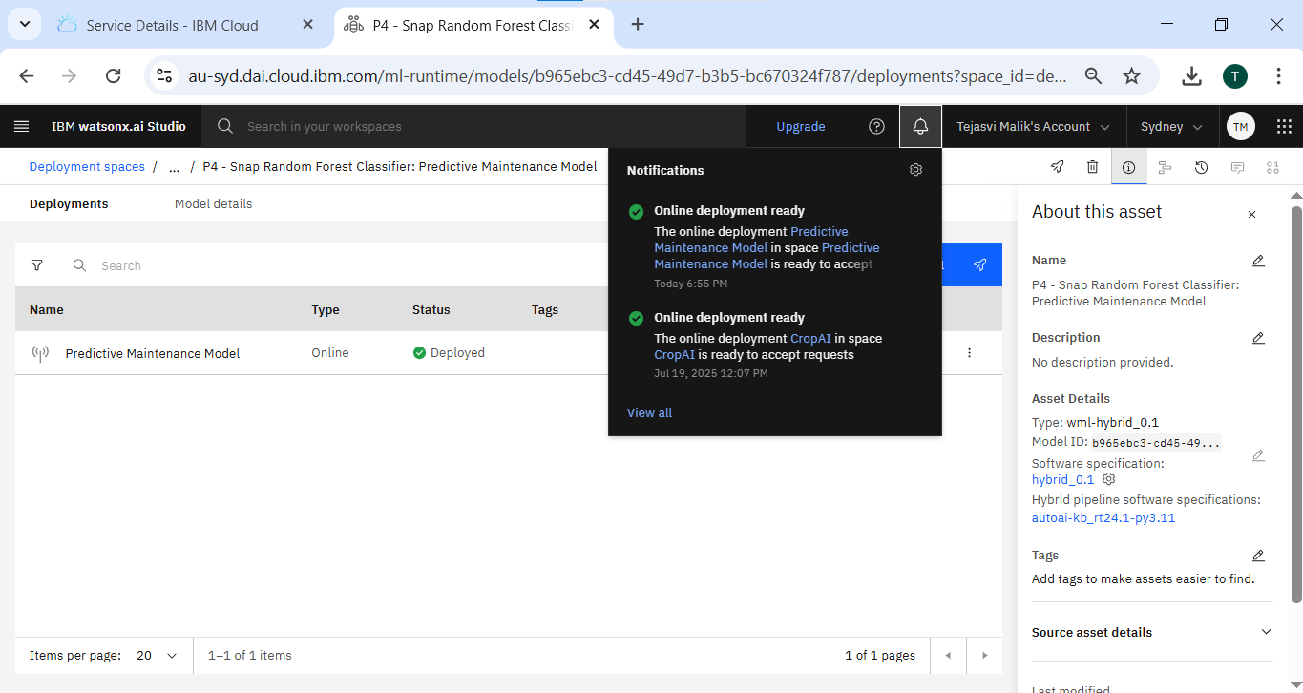
Algorithm & Deployment
Model Building & Selection Stage
Deployment Stage

Slide 8
Result
The SNAP Random Forest Classifier achieved high accuracy in predicting machine failure types, with the top-performing pipeline selected based on cross-validation scores. The model demonstrated strong effectiveness in identifying complex failure patterns, supporting proactive maintenance decisions.

Slide 9
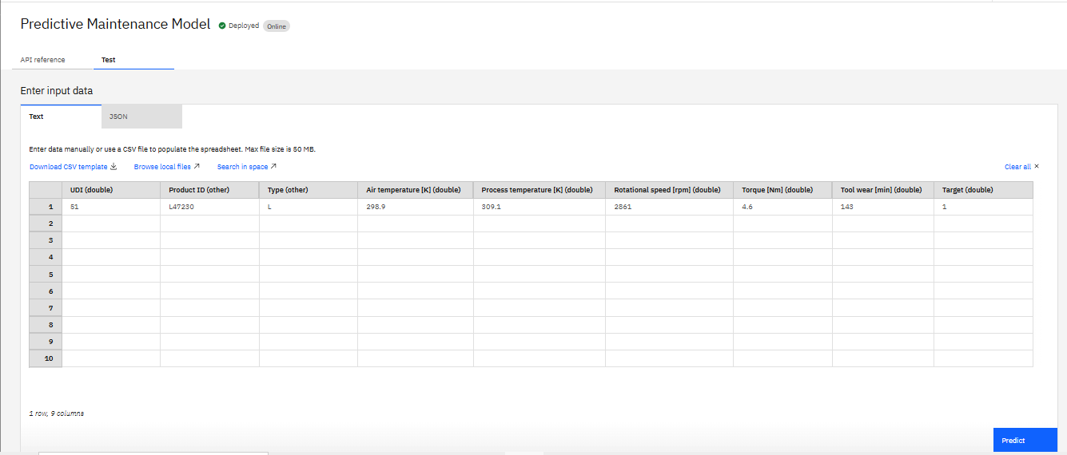
Result
Original values and data from .csv file alongwith its result
Putting same values in model to determine accuracy.

Slide 10
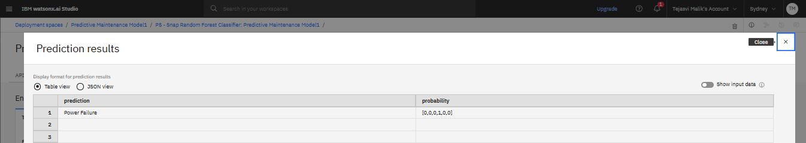
Result
The results showcase the accuracy of the model by providing the correct prediction.
GITHUB REPOSITORY LINK:
https://github.com/tejasvi1211/IBM-PPT.git

Slide 11
Conclusion
The predictive maintenance solution using AutoAI and the SNAP Random Forest Classifier effectively identified machine failure types with high accuracy. This enables timely interventions, reducing unexpected downtime and operational costs. While the no-code AutoAI platform simplified model building, challenges included limited customization and dependence on data quality. Future improvements could involve integrating real-time sensor data and expanding feature engineering. Accurate failure prediction remains crucial for optimizing maintenance schedules and ensuring business continuity.

Slide 12
Future scope
Additional Data Sources: Integrate real-time sensor data, maintenance logs, and environmental conditions to improve model accuracy.
Algorithm Optimization: Experiment with advanced models like ensemble deep learning or anomaly detection for rare failure events.
Scalability: Deploy models using edge computing for on-device inference, enabling faster response times in remote or IoT-enabled environments.
System Expansion: Extend the solution across multiple machine types or facilities, creating a unified predictive maintenance dashboard.

Slide 13
References
IBM Documentation. (2024). Watsonx.ai AutoAI Overview. IBM Cloud. https://www.ibm.com/docs/en/watsonx
Kaggle dataset link – https://www.kaggle.com/datasets/shivamb/machine-predictive-maintenance-classification

Slide 14
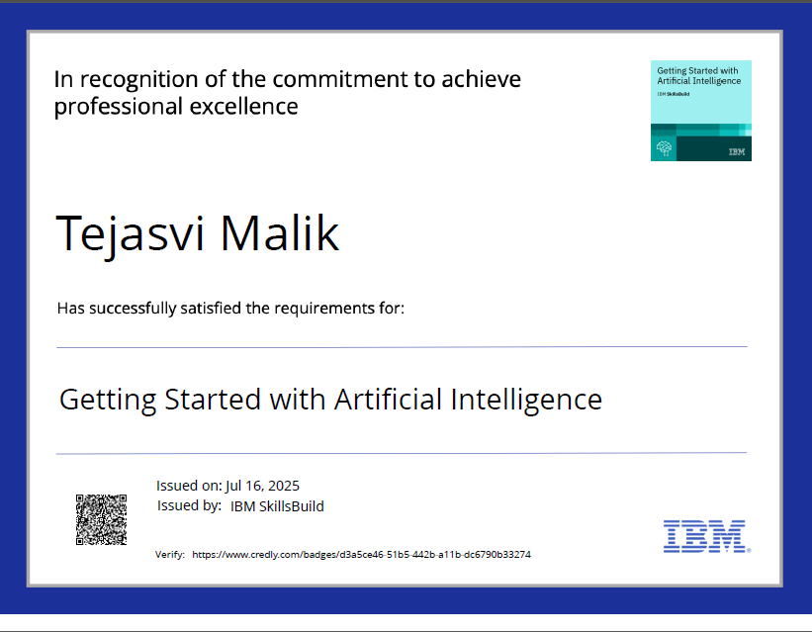
IBM Certifications

Slide 15
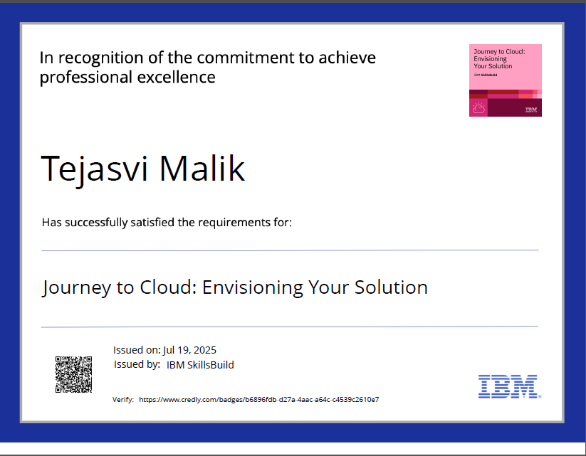
IBM Certifications

Slide 16
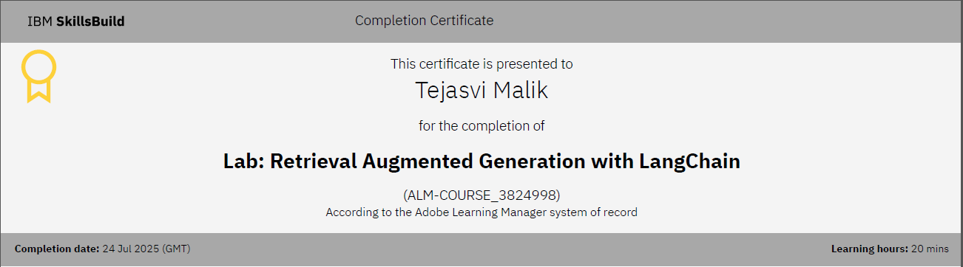
IBM Certifications

Slide 17
THANK YOU

